Slide 1
8. Tokens and NFTs
Mastering Ethereum - Building Smart Contracts and DApps, 2018

Slide 2
Introduction
The association between the word “token” and insignificant value has a lot to do with the limited use of the physical versions of tokens.
Often restricted to specific businesses, organizations, or locations, physical tokens are not easily exchangeable and typically have only one function.
With blockchain tokens, these restrictions are lifted — or, more accurately, completely redefinable.
Many blockchain tokens serve multiple purposes globally and can be traded for each other or for other currencies on global liquid markets.
With the restrictions on use and ownership gone, the “insignificant value” expectation is also a thing of the past.

Slide 3
How Tokens Are Used (1/3)
The most obvious use of tokens is as digital private currencies. However, this is only one possible use. Tokens can be programmed to serve many different functions, often overlapping.
Currency
Token as a form of currency, with a value determined through private trade.
Resource
E.g., a storage or CPU token representing resources that can be shared.
Asset
A token can represent ownership of an intrinsic or extrinsic, tangible or intangible asset; for example, gold, real estate, a car, oil, energy, etc.

Slide 4
How Tokens Are Used (2/3)
Access
A token can represent access rights and grant access to a digital or physical property, such as a discussion forum, a hotel room, or a rental car.
Equity
A token can represent shareholder equity in a digital organization (e.g., a DAO) or legal entity (e.g., a corporation).
Voting
A token can represent voting rights in a digital or legal system.
Collectible
A token can represent a digital collectible (e.g., CryptoPunks) or physical collectible (e.g., a painting).

Slide 5
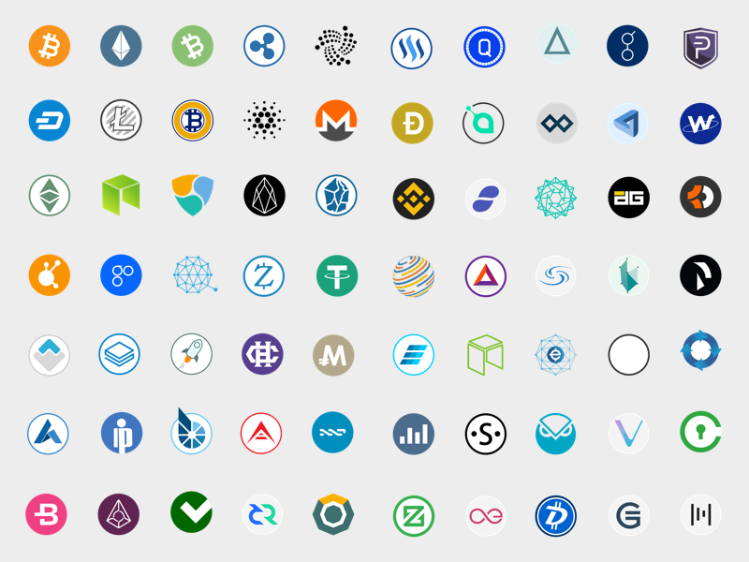
How Tokens Are Used (3/3)
Identity
A token can represent a digital identity (e.g., avatar) or legal identity (e.g., national ID).
Attestation
A token can represent a certification or attestation of fact by some authority or by a decentralized reputation system (e.g., marriage record, birth certificate, college degree).
Utility
A token can be used to access or pay for a service.

Slide 6
Tokens and Fungibility
Wikipedia: In economics, fungibility is the property of a good or a commodity whose individual units are essentially interchangeable.
Tokens are fungible when we can substitute any single unit of the token for another without any difference in its value or function.
Strictly speaking, if a token’s historical provenance can be tracked, then it is not entirely fungible.
Non-fungible tokens (NFTs) are tokens that each represent a unique tangible or intangible item and therefore are not interchangeable.
For example, a token that represents ownership of a specific Van Gogh painting is not equivalent to another token that represents a Picasso, even though they might be part of the same “art ownership token” system.
Each non-fungible token is associated with a unique identifier.

Slide 7
Counterparty Risk
Counterparty risk is the risk that the other party in a transaction will fail to meet their obligations.
Some types of transactions suffer additional counterparty risk because there are more than two parties involved.
In general, when an asset is traded indirectly through the exchange of a token of ownership, there is additional counterparty risk from the custodian of the asset.
In the world of digital tokens representing assets, as in the nondigital world, it is important to understand who holds the asset that is represented by the token and what rules apply to that underlying asset.

Slide 8
Tokens and Intrinsicality (1/2)
The word “intrinsic” derives from the Latin “intra,” meaning “from within.” Some tokens represent digital items that are intrinsic to the blockchain.
Those digital assets are governed by consensus rules, just like the tokens themselves.
This has an important implication: tokens that represent intrinsic assets do not carry additional counterparty risk.
If you hold the keys for a CryptoKitty, there is no other party holding that CryptoKitty for you — you own it directly.
The blockchain consensus rules apply and your ownership (i.e., control) of the private keys is equivalent to ownership of the asset, without any intermediary.

Slide 9
Tokens and Intrinsicality (2/2)
Conversely, many tokens are used to represent extrinsic things, such as real estate, corporate voting shares, trademarks, and gold bars.
The ownership of these items, which are not “within” the blockchain, is governed by law, custom, and policy, separate from the consensus rules that govern the token.
In other words, token issuers and owners may still depend on real-world non-smart contracts. As a result, these extrinsic assets carry additional counterparty risk because they are held by custodians, recorded in external registries, or controlled by laws and policies outside the blockchain environment.
Convert extrinsic into intrinsic to remove counterparty risk: e.g. moving from equity in a corporation (extrinsic) to an equity or voting token in a Decentralized Autonomous Organization (DAO) (intrinsic) organization.

Slide 10
Tokens on Ethereum
Tokens are different from ether because the Ethereum protocol does not know anything about them.
Sending ether is an intrinsic action of the Ethereum platform, but sending or even owning tokens is not.
The ether balance of Ethereum accounts is handled at the protocol level, whereas the token balance of Ethereum accounts is handled at the smart contract level.
In order to create a new token on Ethereum, you must create a new smart contract. Once deployed, the smart contract handles everything, including ownership, transfers, and access rights.
You can write your smart contract to perform all the necessary actions any way you want, but it is probably wisest to follow an existing standard.

Slide 11
The ERC20 Token Standard (1/2)
First standard introduced in November 2015 by Fabian Vogelsteller as an Ethereum Request for Comments (ERC).
The vast majority of tokens are currently based on the ERC20 standard.
The ERC20 eventually became Ethereum Improvement Proposal 20 (EIP-20), but it is mostly still referred to by the original name, ERC20.
ERC20 is a standard for fungible tokens, meaning that different units of an ERC20 token are interchangeable and have no unique properties.
The ERC20 standard defines a common interface for contracts implementing a token, such that any compatible token can be accessed and used in the same way. The interface consists of a number of functions that must be present in every implementation of the standard, as well as some optional functions and attributes that may be added by developers.

Slide 12
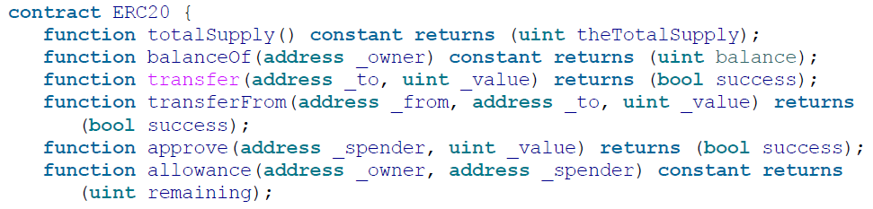
The ERC20 Token Standard (2/2)
An ERC20-compliant token contract must provide at least the following functions and events:
Interface specification in Solidity

Slide 13
ERC20 data structures
If you examine any ERC20 implementation you will see that it contains two data structures, one to track balances and one to track allowances. In Solidity, they are implemented with a data mapping.
The first data mapping implements an internal table of token balances, by owner. This allows the token contract to keep track of who owns the tokens. Each transfer is a deduction from one balance and an addition to another balance (via “transfer”).
The second data structure is a data mapping of allowances. With ERC20 tokens an owner of a token can delegate authority to a spender, allowing them to spend a specific amount (allowance) from the owner’s balance.
The ERC20 contract keeps track of the allowances with a two-dimensional mapping, with the primary key being the address of the token owner, mapping to a spender address and an allowance amount. (via “transferFrom”)

Slide 14
ERC20 Workflows
“transfer”
This single-transaction and straightforward workflow is the one used by wallets to send tokens to other wallets.
“approve & transferFrom”
A two-transaction workflow that uses approve followed by transferFrom.
This workflow allows a token owner to delegate their control to another address. It is most often used to delegate control to a contract for distribution of tokens, but it can also be used by exchanges.
E.g., if a company is selling tokens for an ICO (Initial Coin Offering), they can approve a crowdsale contract address to distribute a certain amount of tokens. The crowdsale contract can then transferFrom the token contract owner’s balance to each buyer of the token.

Slide 15
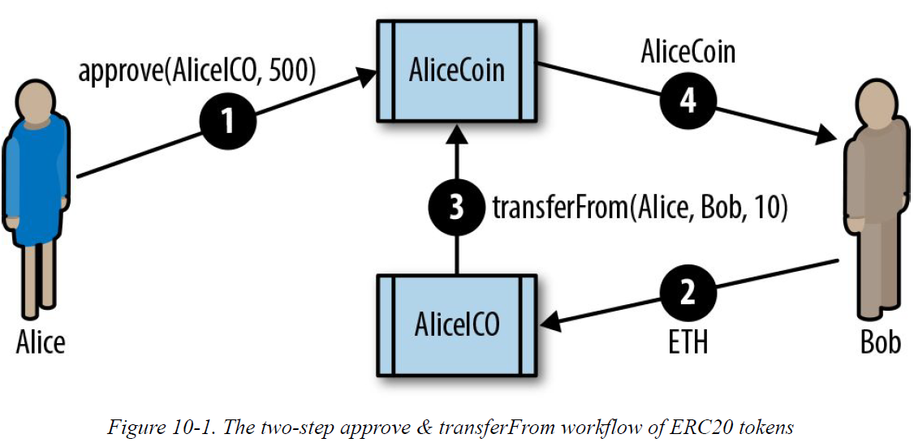
E.g. “approve & transferFrom” Workflow

Slide 16
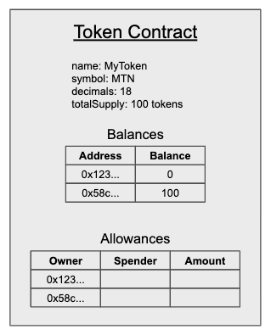
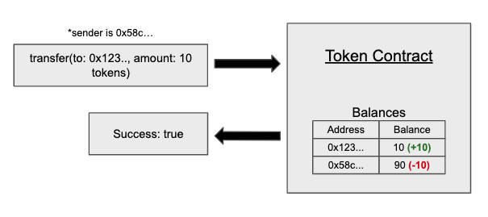
Ref. A Straightforward Guide to ERC20 Tokens (1/2)
https://docs.ethhub.io/guides/a-straightforward-guide-erc20-tokens/

Slide 17
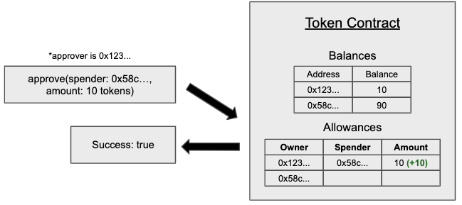
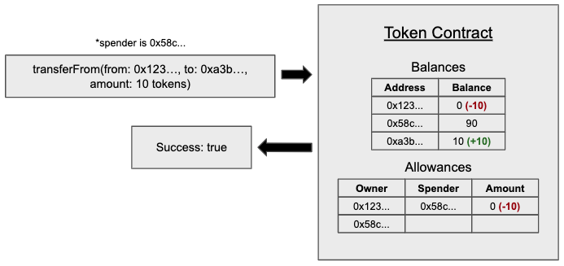
Ref. A Straightforward Guide to ERC20 Tokens (2/2)

Slide 18

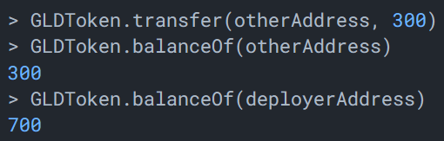
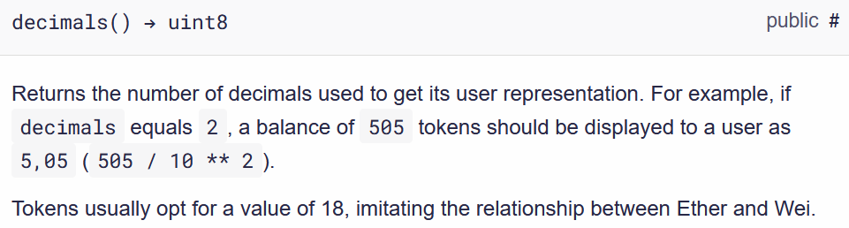
Decimals for ERC20 Tokens (1/3)
https://docs.openzeppelin.com/contracts/2.x/erc20
E.g. initialSupply = 1000 for GLDToken
decimals = 18 (default)

Slide 19
Decimals for ERC20 Tokens (2/3)
It is important to understand that decimals is only used for display purposes. All arithmetic inside the contract is still performed on integers, and it is the different user interfaces (wallets, exchanges, etc.) that must adjust the displayed values according to decimals.
The total token supply and balance of each account are not specified in GLD: you need to divide by 10^decimals to get the actual GLD amount.
When minting tokens or transferring them around, you will be actually sending the number num GLD * 10^decimals.
E.g. If you want to mint/transfer 100 GLD tokens (with decimals = 18), you should use the number 100 * 10¹⁸.

Slide 20
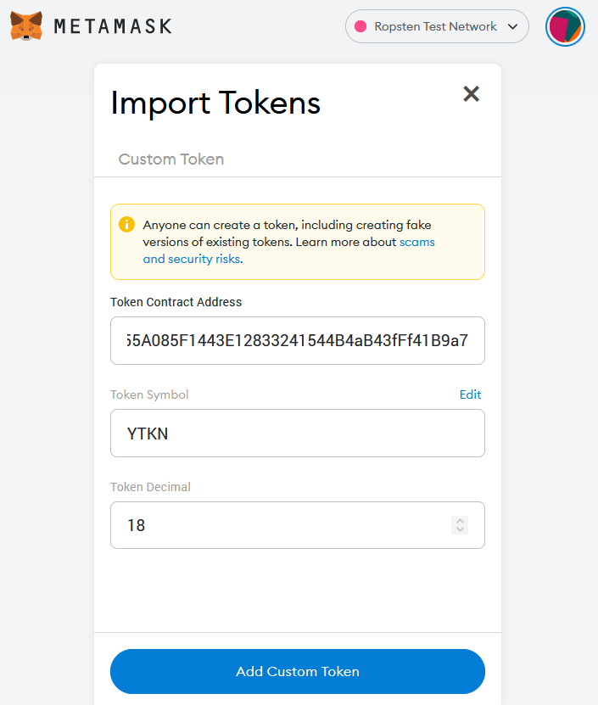
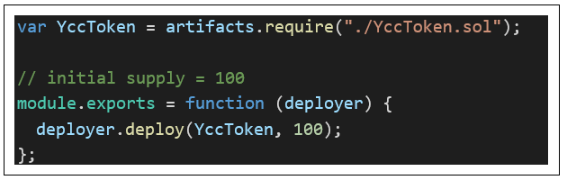
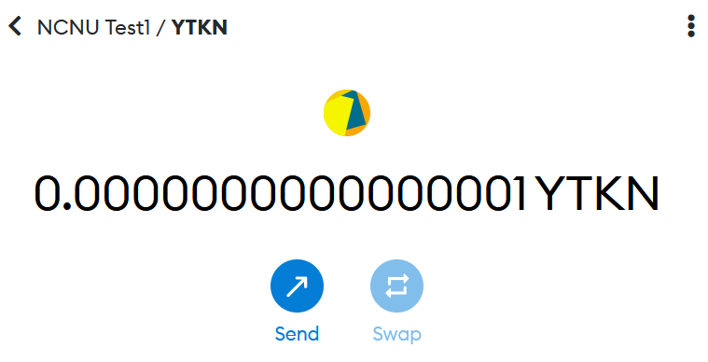
Decimals for ERC20 Tokens (3/3)
= 10⁻¹⁶

Slide 21
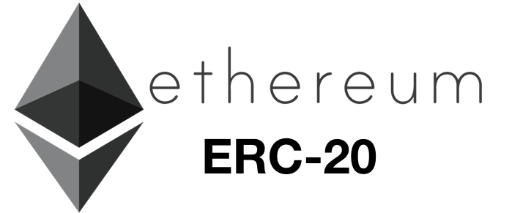
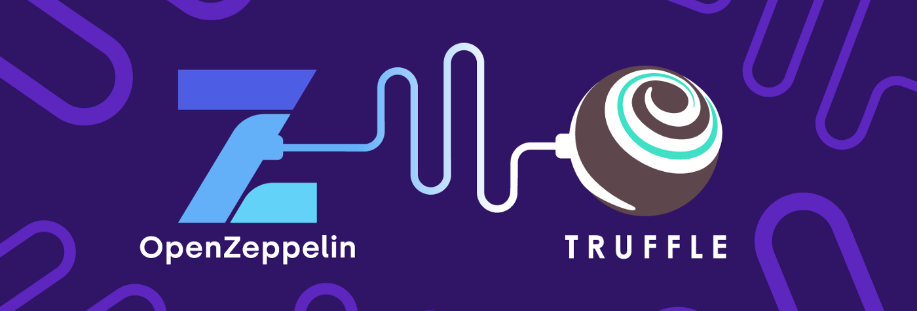
Homework-3: Launching Your Own ERC20 Token
Programming an ERC20 Token Contract using Truffle & OpenZeppelin. (P.442 on the book)

Slide 22
Ref. What Are EIP and ERC and How Are They Connected? (1/2)
https://www.coindesk.com/learn/what-are-eip-and-erc-and-how-are-they-connected/
Anyone with enough technical proficiency can write, edit and submit Ethereum Improvement Proposals (EIPs) for new functionality or features that they would like to implement according to the guidelines in the EIP-1, which was published in 2015.
The EIP-1 is a highly recommended resource for prospective authors or contributors because it outlines all critical aspects related to EIPs, such as the process, definitions and types of EIPs, the EIP format and template, as well as a list editors and more.
EIPs (which include ERCs) are the central unit around which governance (decisions) happen and are documented on Ethereum.

Slide 23
Ref. What Are EIP and ERC and How Are They Connected? (2/2)
As stated in EIP-1, Ethereum Request for Comment (ERC) relates to a specific category of Standards Track EIP.
A Standards Track EIP describes any change that affects most or all Ethereum implementations and can be broken down into different subcategories such as core, networking, interface and ERC.
The main difference in these subcategories of Standards Track EIP is where it's deployed.
For example, ERCs are deployed at the application level. They don't need to be adopted by all participants, unlike core which is deployed at the protocol level and requires a broader consensus in the community, as all core EIPs must be widely adopted (all nodes must upgrade to remain part of the network).

Slide 24
Issues with ERC20 Tokens (1/3)
ERC20 tokens expose subtle differences between tokens & ether itself.
Where ether is transferred by a transaction that has a recipient address as its destination, token transfers occur within the specific token contract state and have the token contract as their destination, not the recipient’s address.
In a token transfer, no transaction is actually sent to the recipient of the token. Instead, the recipient’s address is added to a map within the token contract.
A transaction sending ether to an address changes the state of an address.
A transaction transferring a token to an address only changes the state of the token contract, not the state of the recipient address.
Even a wallet that has support for ERC20 tokens does not become aware of a token balance unless the user explicitly adds a specific token contract to “watch.”

Slide 25
Issues with ERC20 Tokens (2/3)
In fact, it’s unlikely that a user would want to track all balances in all possible ERC20 token contracts. Many ERC20 tokens are more like email spam than usable tokens.
They automatically create balances for accounts that have ether activity, in order to attract users.
If you have an Ethereum address with a long history of activity, especially if it was created in the presale, you will find it full of “junk” tokens that appeared out of nowhere.
Of course, the address isn’t really full of tokens; it’s the token contracts that have your address in them.
You only see these balances if these token contracts are being watched by the block explorer or wallet you use to view your address.

Slide 26
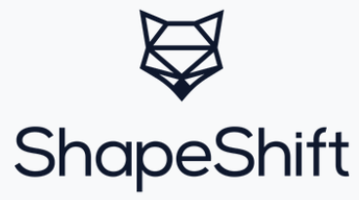
Issues with ERC20 Tokens (3/3)
To send ether or use any Ethereum contract you need ether to pay for gas. To send tokens, you also need ether. You cannot pay for a transaction’s gas with a token and the token contract can’t pay for the gas for you.
This can cause some rather strange user experiences. E.g., let’s say you use an exchange or ShapeShift to convert some bitcoin to a token. You “receive” the token in a wallet that tracks that token’s contract and shows your balance. It looks the same as any of the other cryptocurrencies you have in your wallet. Try sending the token, though, and your wallet will inform you that you need ether to do that. You might be confused — after all, you didn’t need ether to receive the token. Perhaps you have no ether. Perhaps you didn’t even know the token was an ERC20 token on Ethereum; maybe you thought it was a cryptocurrency with its own blockchain. The illusion just broke.

Slide 27
ERC721: Non-Fungible Token Standard (1/3)
The ERC721 proposal is for a standard for non-fungible tokens, also known as deeds.
deed: a legal document that is signed and delivered, especially one regarding the ownership of property or legal rights. (Oxford Dictionary)
Non-fungible tokens track ownership of a unique thing. The thing owned can be a digital item, such as an in-game item or digital collectible; or the thing can be a physical item whose ownership is tracked by a token, such as a house, a car, or an artwork. Deeds can also represent things with negative value, such as loans (debt), liens, easements, etc.
ERC721 places no limitation or expectation on the nature of the thing whose ownership is tracked by a deed and requires only that it can be uniquely identified, which in the case of ERC721 is achieved by a 256-bit identifier.

Slide 28
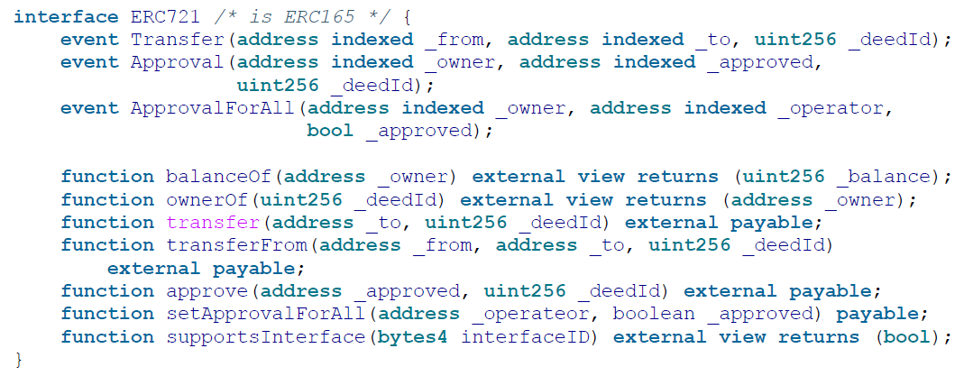
ERC721: Non-Fungible Token Standard (2/3)
Difference between ERC20 and ERC721
Whereas ERC20 tracks the balances that belong to each owner, with the owner being the primary key of the mapping, ERC721 tracks each deed ID and who owns it, with the deed ID being the primary key of the mapping.
The ERC721 contract interface specification

Slide 29
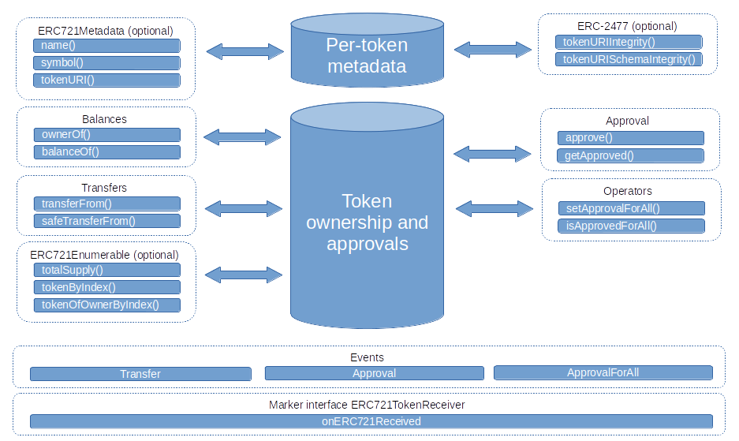
ERC721: Non-Fungible Token Standard (3/3)

Slide 30
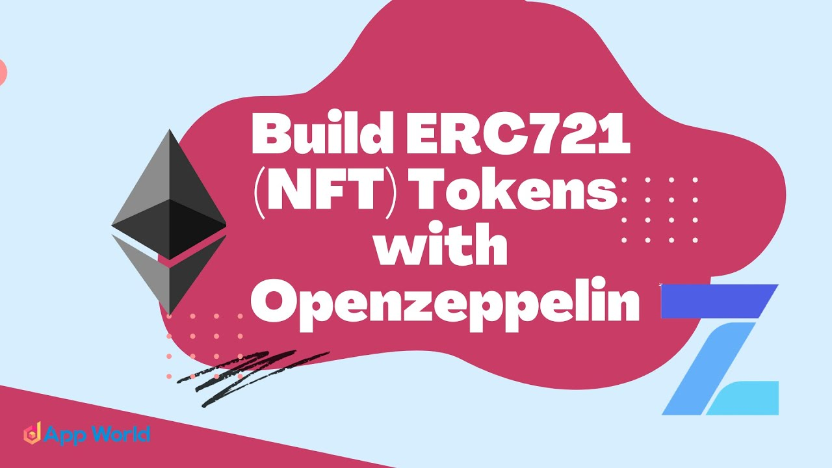
Homework-4: Launching Your Own NFT
Programming an ERC721 Token Contract using Truffle & OpenZeppelin.

Slide 31
Extensions to Token Interface Standards
Token standards are the minimum specifications for an implementation.
Q: Should You Use These Standards?
Interoperability, Restrictions, Security
The token standards discussed in this chapter provide a very minimal interface, with limited functionality. Many projects have created extended implementations to support features that they need for their applications.
Some of the features include: Owner control, Burning, Minting, Crowdfunding, Caps, Recovery backdoors, Whitelisting, Blacklisting
There are reference implementations for many of these functions, for example in the OpenZeppelin library.

Slide 32
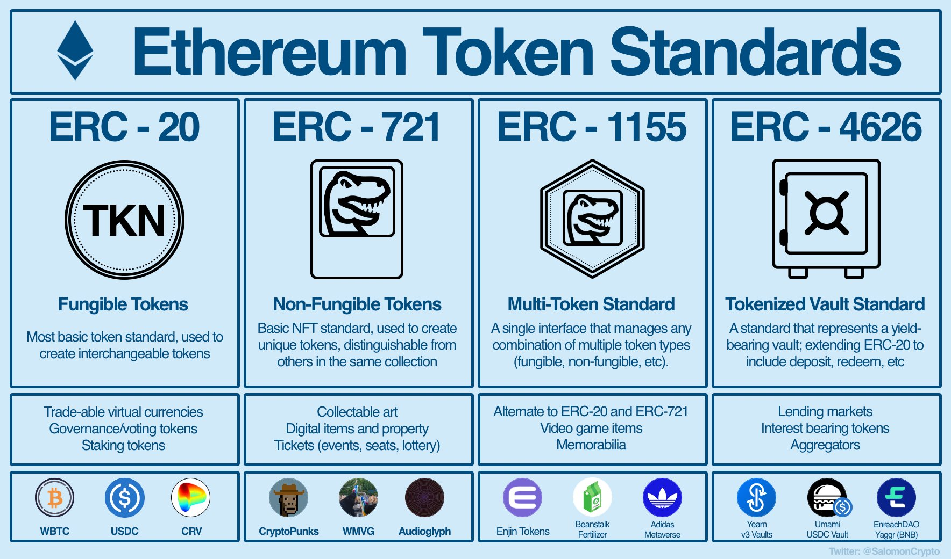
https://twitter.com/SalomonCrypto/status/1553982842232717313
https://ethereum.org/zh-tw/developers/docs/standards/tokens/

Slide 33
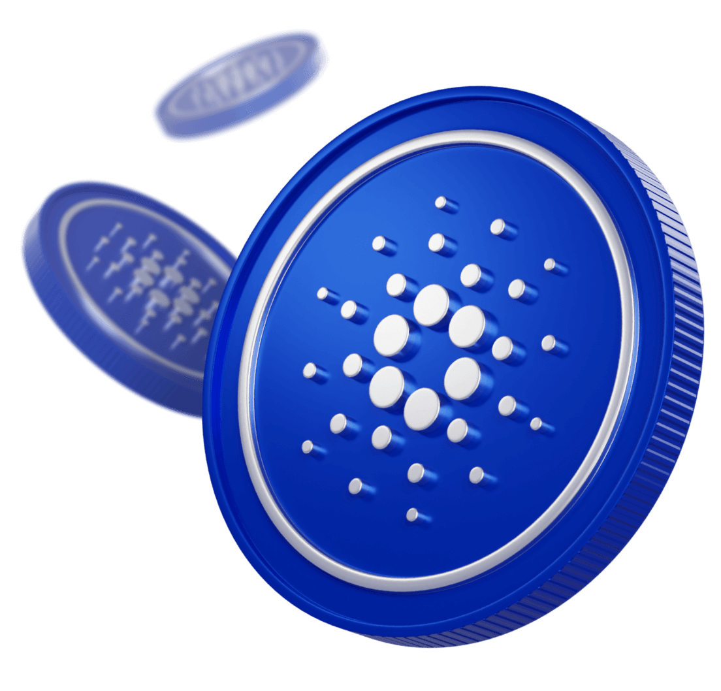
Ref. Cardano (ADA) Native Tokens
https://developers.cardano.org/docs/native-tokens/
https://docs.cardano.org/native-tokens/learn
The Cardano Blockchain has the unique ability to create, interact with, and delete tokens (or 'assets') natively. In this example, native means that, in addition to sending and receiving the official currency ADA, you may interact with custom assets right out of the box - without the use of smart contracts.

Slide 34
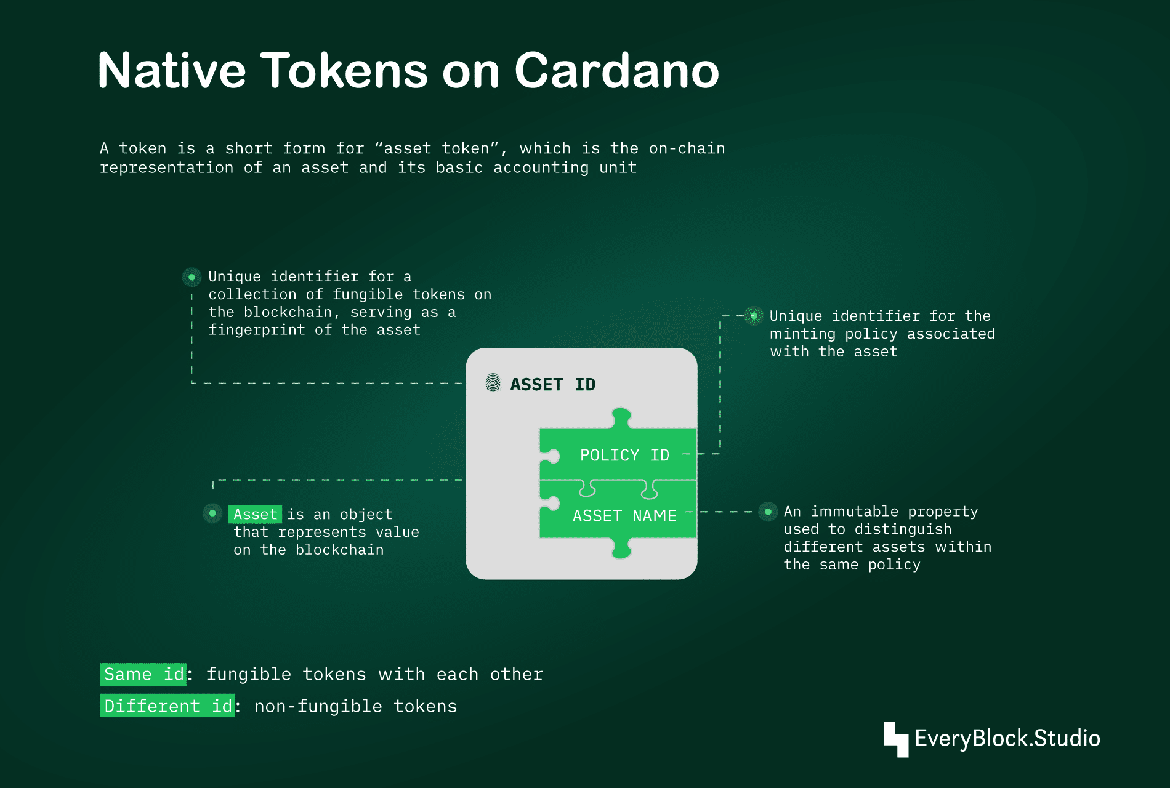
https://slides.com/everyblockstudio/native-tokens-on-cardano

Slide 35
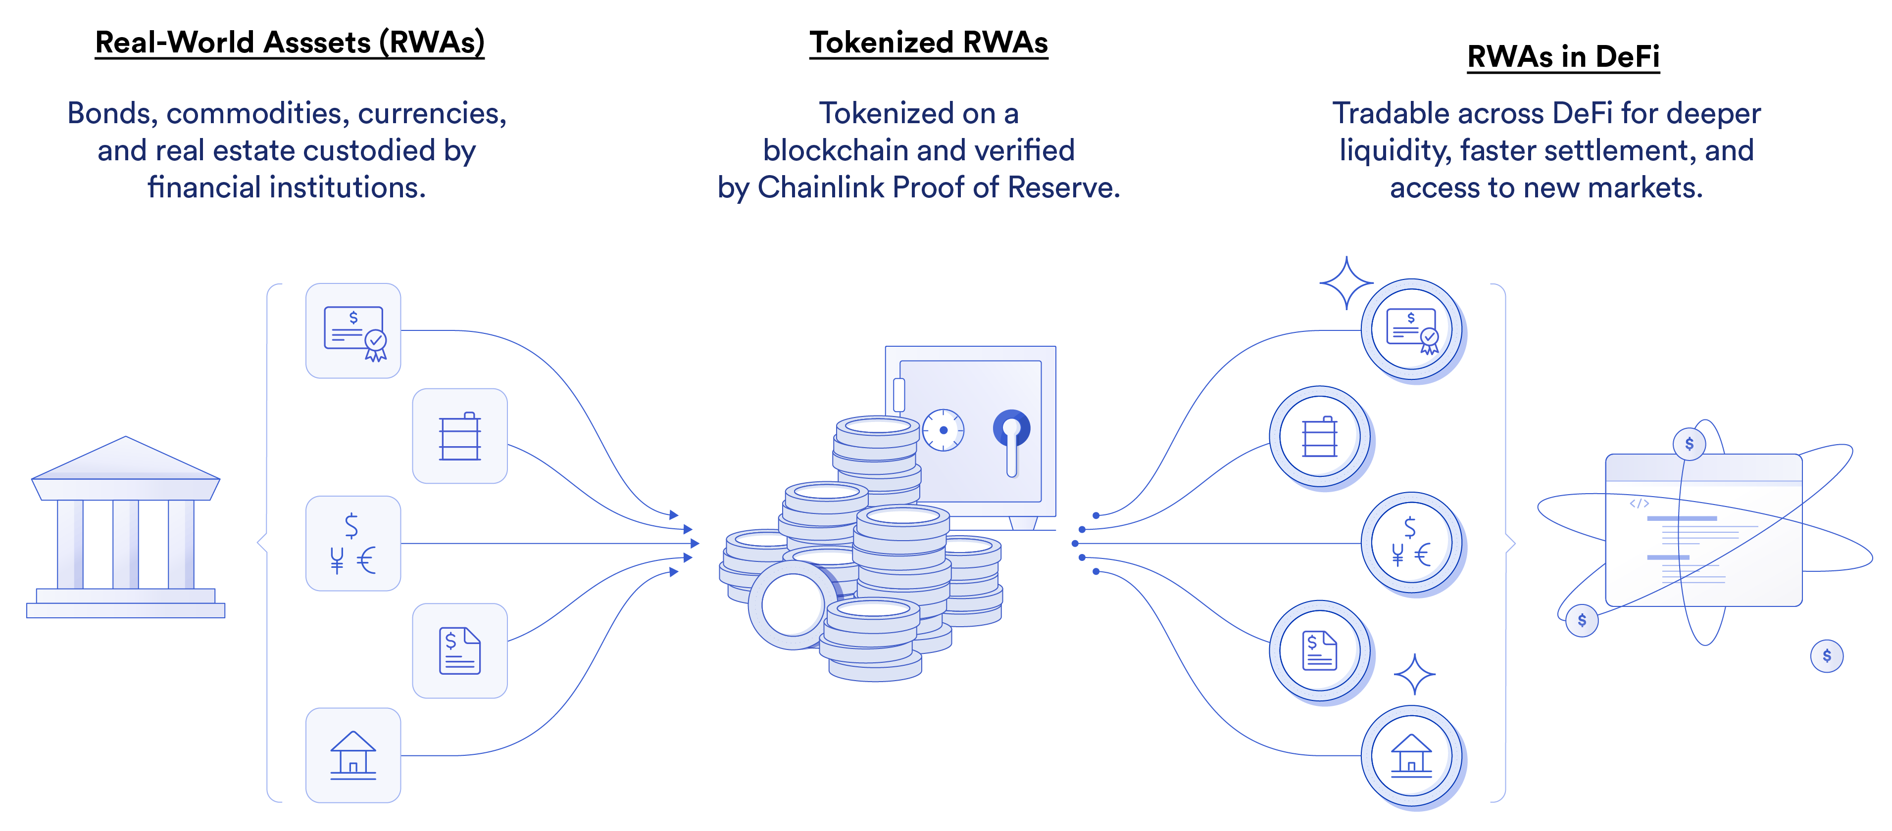
Ref. How to Tokenize an Asset
https://blog.chain.link/how-to-tokenize-an-asset/

